Slide 1
Cpu and Memory

Slide 2
Kubernetes Cluster
In any given cluster with multiple nodes, there are a defined set of resources in the form of
CPU
Memory
CPU and memory are collectively referred to as compute resources, or just resources. These resources are measurable quantities that can be requested, allocated, and consumed.

Slide 3
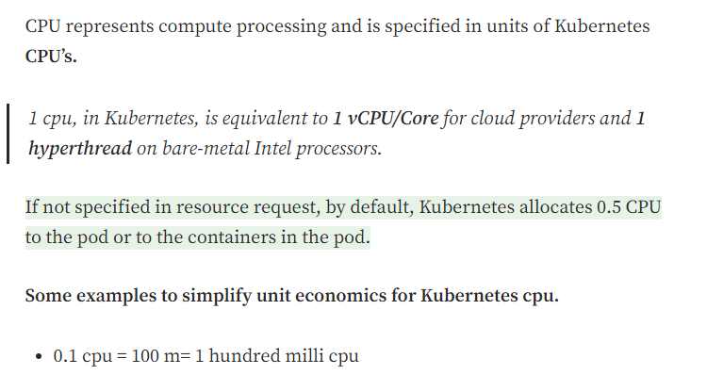
CPU:
Each of the above resource types has a base unit, let get into the details of each one by one.

Slide 4
Memory
In Kubernetes requests for memory, resources are measured in bytes. The memory can be represented both as fixed point integer or power-of-two equivalent.
You can express memory as a plain integer or as a fixed-point integer using one of these suffixes: E, P, T, G, M, K. You can also use the power-of-two equivalents: Ei, Pi, Ti, Gi, Mi, Ki. For example, the following represent roughly the same value: 128974848, 129e6, 129M, 123Mi
5G means 5 Gigabytes while 5Gi means 5 Gibibytes. They amount to:
5 G = 5000000 KB / 5000 MB
5 Gi = 5368709.12 KB / 5368.70 MB

Slide 5
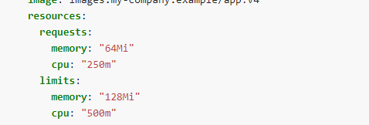
Example

Slide 6
..
Requests is a K8s concept used for scheduling pods within the underlying infrastructure: “place my pod’s containers where there are enough of these resources to accommodate them”.
Limits is a hard cap on the resources made available to container that propagates to the underlying container runtime
If requests is omitted for a container, it defaults to limits. If limits is not set, it defaults to 0 (unbounded).

